Slide 1
Army STANDARD TRAINING PACKAGE
Notes:
Select Note Pages contain instruction comments to assist with your presentation.
This Standard Training Package (STP) is current as of 13 September 2023. To ensure this is the most current version, please go to https://tjaglcspublic.army.mil/ and locate the STPs within the "Training" area/box of the tjaglcspublic site.

Slide 2
Revisions to FM 3-84, Legal support to operations, 8 Sep 23

Slide 3
CONTENTS
The Role of Doctrine
Changes in FM 3-84
Four Constants
Updates to Core Legal Functions
Multidomain Operations - the Army’s Operational Concept
Sample Legal Estimate
JAG Corps Mission Essential Task List (METL)
Notes:
Instructor Comments:
The following slides provide a brief overview of the major changes to FM 3-84.
The intent is to become aware of changes to the manual, and provide a reminder of the role doctrine plays in Army operations

Slide 4
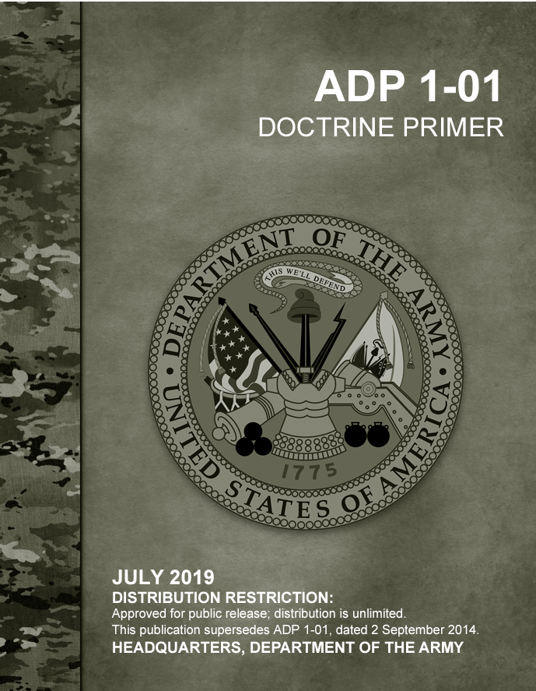
the role of doctrine
Doctrine consists of validated principles and TTPs for the Army forces currently fielded, trained, and equipped, while concepts are ideas for significant change
The primary sources of legal doctrine are:
JP 3-84, Legal Support, 2 Aug 16
FM 3-84, Legal Support to Operations, Sep 2023
OSTC not a part of the revised FM; principles and TTPs are still under development
Notes:
Instructor Comments:
Doctrine is a collection of validated principles and TTPs. It is informed by past experience and assumptions about the future environment
Doctrine is constantly evolving- FM 3-84 will undergo another significant revision to incorporate those principles and TTPs developed during the implementation of the Office of the Special Trial Counsel

Slide 5
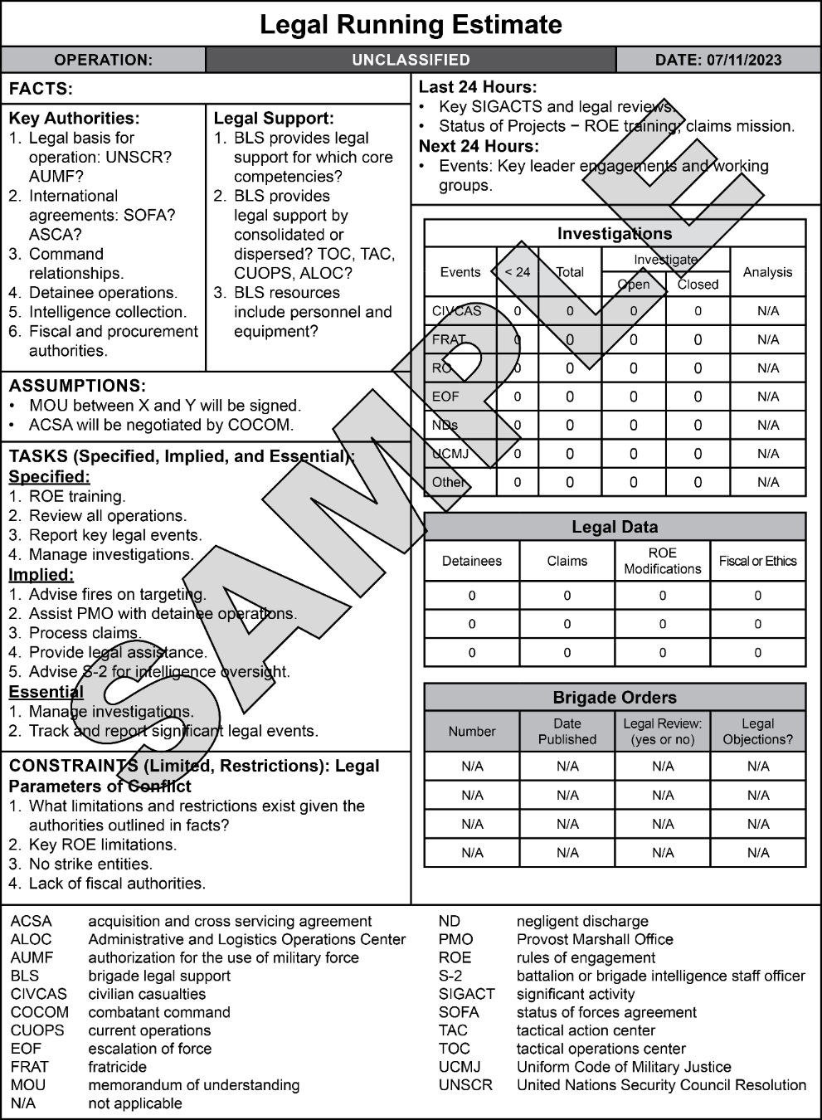
Changes in FM 3-84
Name changed from FM 1-04 to FM 3-84 to conform with JP 3-84 and highlight the role of JAs in operations
Added Four Constants
Updated core legal functions with new examples
Incorporated changes to FM 3-0 with a focus on multidomain operations
Added a practical running estimate appendix
Notes:
2
Instructor Comments:
We didn’t add details on the Office of the Special Trial Counsel (OSTC) yet. We made a deliberate decision not to incorporate the OSTC into this publication of FM 3-84. Doctrine consists of validated principles and TTPs for the Army forces currently fielded, trained, and equipped, while concepts are ideas for significant change.
Recognizing that the OSTC will have a significant impact on how our Corps provides legal support to operations, it is important that we get the doctrine for that support correct. TJAGLCS will immediately start working on a “change” (the doctrinal equivalent of a rapid action revision) to FM 3-84 that will incorporate the validated TTPs learned from OSTC implementation.

Slide 6
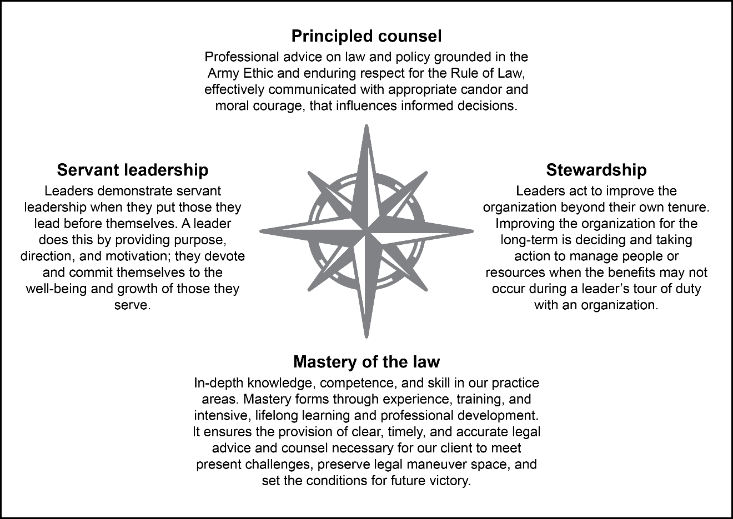
Four Constants
Definitions now in doctrine
JALS personnel must be familiar with the Constants – should inform all areas of practice
Notes:
Instructor Comments:
Added Four Constants – underpins all JAG Corps practice

Slide 7
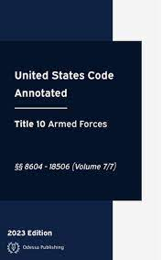
Updates to Core legal functions
Adds:
Acquisition Law
Legal Support to Space Operations
Recognition of the increasing complexity of legal practice
Legal offices must be prepared to support all phases and domains of operations
Notes:
Instructor Comments:
4-24. Acquisition law governs the Army requirements process from initial requirement development to contract close out and final fund disbursement
4-52. Legal support to space operations requires practitioners to understand and apply international and operational law. Space operations typically involve activities in and through the electromagnetic spectrum with effects in or through outer space. This requires analyzing specialized legal issues from various bodies of law including the Outer Space Treaty and the International Telecommunications Union in addition to the LOAC. The analysis may include evaluating multiple international legal regimes, making a core understanding of international law vital

Slide 8
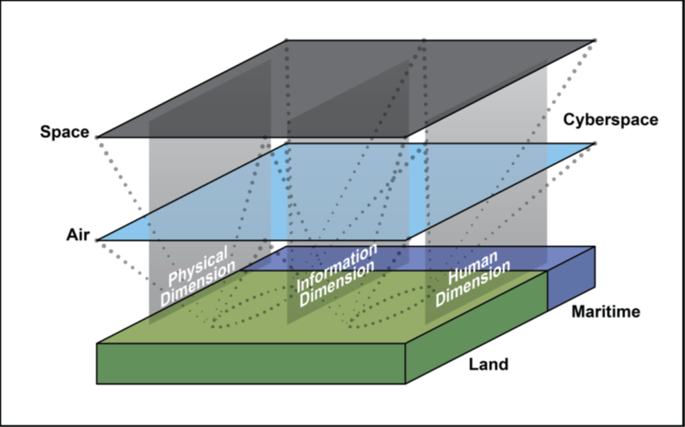
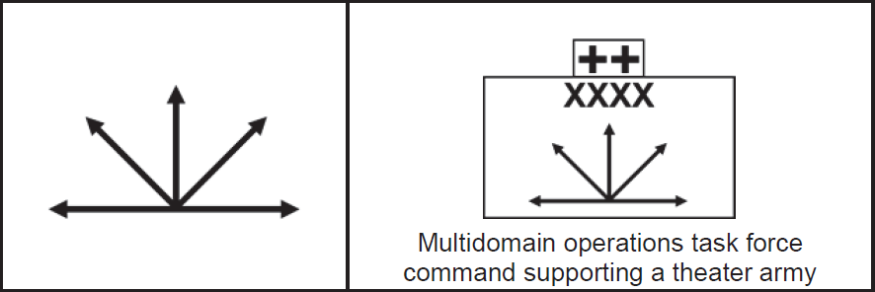
Multidomain Operations - the Army’s Operational Concept
FM 3-84 incorporates the Army’s current operational concept of Multidomain Operations (MDO)
Requires JAG Corps personnel to integrate early and at each echelon
Requires familiarity with FM 3-0, Operations, 1 Oct 2022
Notes:
Instructor Comments:
The Army's operational concept is multidomain operations. Multidomain operations are how Army forces enable and operate as part of the joint force against threats able to contest it in all domains. Army forces, enabled by joint capabilities, attack enemy forces and protect friendly forces through all domains.
Concept is complex; legal personnel must be familiar with terminology and principles to gain and maintain trust with commanders and their staffs

Slide 9
Legal Running estimate
FM incorporates a sample Legal Running Estimate, informed by the OC/Ts at Combat Training Centers
Legal offices are encouraged to exercise MDMP and develop TTPs for tracking and managing legal operations
Running estimates and similar concepts are not limited to NSL practice
Notes:
Instructor Comments:
FM provides a template or sample legal running estimate
Legal offices should not feel that these types of products are limited to NSL practice; could be incorporated into various areas of legal practice

Slide 10
JAG Corps metl https://tjaglcs.army.mil/resources/jag-corps-metl
Although not part of FM 3-84, the JAG Corps METL is influenced by the FM, and vice versa
The JAGC METL consists of 14 mission essential tasks (METs), 42 supporting collective tasks (SCTs), and 56 training and evaluation outlines (T&EOs).
In the METL Cross-walk, the SCTs align with the METs and our legal functions. The T&EOs describe the references, tasks, conditions, standards, evaluation criteria, and performance steps and measures for each MET and SCT.
The JAG Corps METL should be used to inform OSJA training plans
Notes:
Instructor Comments:
The JAG Corps METL is a product internal to the JAG Corps; it is not staffed through the Army’s Standards for Training Readiness Advisory Group (STRAG) validation process.
There are two JAG units that have STRAG validated METLs, both are in COMPO 3:
Legal Operations Detachment – Multifunctional (LOD-M)
Legal Operations Detachment – Trial Defense (LOD-TD)
There are 7 JAG Corps units, in COMPOs 1 and 3, that have received exemptions from HQDA to have an approved METL. They are:
Legal Operations Detachment – Judicial (LOD-J)
Legal Operations Detachment – Expert (LOD-E)
Senior Special Victims Counsel Team
Field Special Victims Counsel Team
Regional Trial Defense Team
Senior Trial Defense Team
Field Trial Defense Team

Slide 11
Questions
Notes:
Instruction Note:
Questions or comments about this brief may be referred to the Educational Technology Distributed Learning Division, The Judge Advocate General’s Legal Center and School (TJAGLCS), by submitting a helpdesk ticket at JAG University at https://jagu.army.mil

